Slide 1
CS 252 Database Management Systems
Jan – May 2020
IV Semester
* Use the slides for reference only. Refer the text book for details.

Slide 2
Relational Algebra Operations from Set Theory: UNION
UNION Operation
Binary operation denoted by ∪
The result of R ∪ S, is a relation that includes all tuples that are either in R or in S or in both R and S
Duplicate tuples are eliminated
The two operand relations R and S must be “type compatible” (or UNION compatible)
R and S must have same number of attributes
Each pair of corresponding attributes must be type compatible (have same or compatible domains)

Slide 3
Relational Algebra Operations from Set Theory: UNION
Example:
To retrieve the social security numbers of all employees who either work in department 5 (RESULT1 below) or directly supervise an employee who works in department 5 (RESULT2 below)
We can use the UNION operation as follows:
DEP5_EMPS ← σ_{DNO=5} (EMPLOYEE)
RESULT1 ← π _{SSN}(DEP5_EMPS)
RESULT2(SSN) ← π_{SUPERSSN}(DEP5_EMPS)
RESULT ← RESULT1 ∪ RESULT2
The union operation produces the tuples that are in either RESULT1 or RESULT2 or both

Slide 4
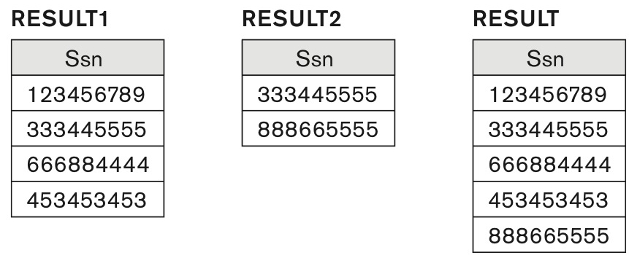
Result of the UNION operation RESULT ← RESULT1 ∪ RESULT2.

Slide 5
Relational Algebra Operations from Set Theory
Type Compatibility of operands is required for the binary set operation UNION ∪, (also for INTERSECTION ∩, and SET DIFFERENCE –)
R1(A1, A2, ..., An) and R2(B1, B2, ..., Bn) are type compatible if:
they have the same number of attributes, and
the domains of corresponding attributes are type compatible (i.e. dom(Ai)=dom(Bi) for i=1, 2, ..., n).
The resulting relation for R1∪R2 (also for R1∩R2, or R1–R2, see next slides) has the same attribute names as the first operand relation R1 (by convention)

Slide 6
Relational Algebra Operations from Set Theory: INTERSECTION
INTERSECTION is denoted by ∩
The result of the operation R ∩ S, is a relation that includes all tuples that are in both R and S
The attribute names in the result will be the same as the attribute names in R
The two operand relations R and S must be “type compatible”

Slide 7
Relational Algebra Operations from Set Theory: SET DIFFERENCE
SET DIFFERENCE (also called MINUS or EXCEPT) is denoted by –
The result of R – S, is a relation that includes all tuples that are in R but not in S
The attribute names in the result will be the same as the attribute names in R
The two operand relations R and S must be “type compatible”

Slide 8
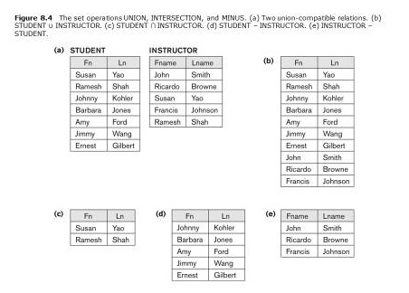
Example to illustrate the result of UNION, INTERSECT and DIFFERENCE

Slide 9
Properties of UNION, INTERSECT, and DIFFERENCE
Notice that both union and intersection are commutative operations; that is
R ∪ S = S ∪ R, and R ∩ S = S ∩ R
Both union and intersection can be treated as n-ary operations applicable to any number of relations as both are associative operations; that is
R ∪ (S ∪ T) = (R ∪ S) ∪ T
(R ∩ S) ∩ T = R ∩ (S ∩ T)
The minus operation is not commutative; that is, in general
R – S ≠ S – R

Slide 10
Relational Algebra Operations from Set Theory: CARTESIAN PRODUCT
CARTESIAN (or CROSS) PRODUCT Operation
This operation is used to combine tuples from two relations in a combinatorial fashion.
Denoted by R(A1, A2, . . ., An) x S(B1, B2, . . ., Bm)
Result is a relation Q with degree n + m attributes:
Q(A1, A2, . . ., An, B1, B2, . . ., Bm), in that order.
The resulting relation state has one tuple for each combination of tuples—one from R and one from S.
Hence, if R has n_{R} tuples (denoted as |R| = n_{R} ), and S has n_{S} tuples, then R x S will have n_{R} * n_{S} tuples.
The two operands do NOT have to be "type compatible”

Slide 11
Relational Algebra Operations from Set Theory: CARTESIAN PRODUCT
Generally, CROSS PRODUCT is not a meaningful operation
Can become meaningful when followed by other operations
Example (not meaningful):
FEMALE_EMPS ← σ _{SEX=’F’}(EMPLOYEE)
EMPNAMES ← π _{FNAME, LNAME, SSN} (FEMALE_EMPS)
EMP_DEPENDENTS ← EMPNAMES x DEPENDENT
EMP_DEPENDENTS will contain every combination of EMPNAMES and DEPENDENT
whether or not they are actually related

Slide 12
Relational Algebra Operations from Set Theory: CARTESIAN PRODUCT
To keep only combinations where the DEPENDENT is related to the EMPLOYEE, we add a SELECT operation as follows
Example (meaningful):
FEMALE_EMPS ← σ _{SEX=’F’}(EMPLOYEE)
EMPNAMES ← π _{FNAME, LNAME, SSN} (FEMALE_EMPS)
EMP_DEPENDENTS ← EMPNAMES x DEPENDENT
ACTUAL_DEPS ← σ _{SSN=ESSN}(EMP_DEPENDENTS)
RESULT ← π _{FNAME, LNAME, DEPENDENT_NAME} (ACTUAL_DEPS)
RESULT will now contain the name of female employees and their dependents

Slide 13
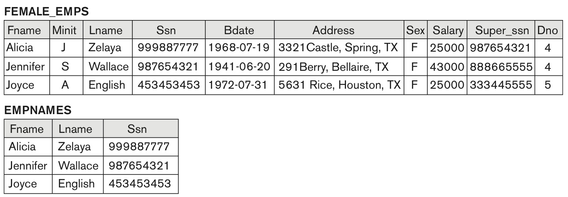
Example of CARTESIAN PRODUCT (CROSS PRODUCT) operation

Slide 14
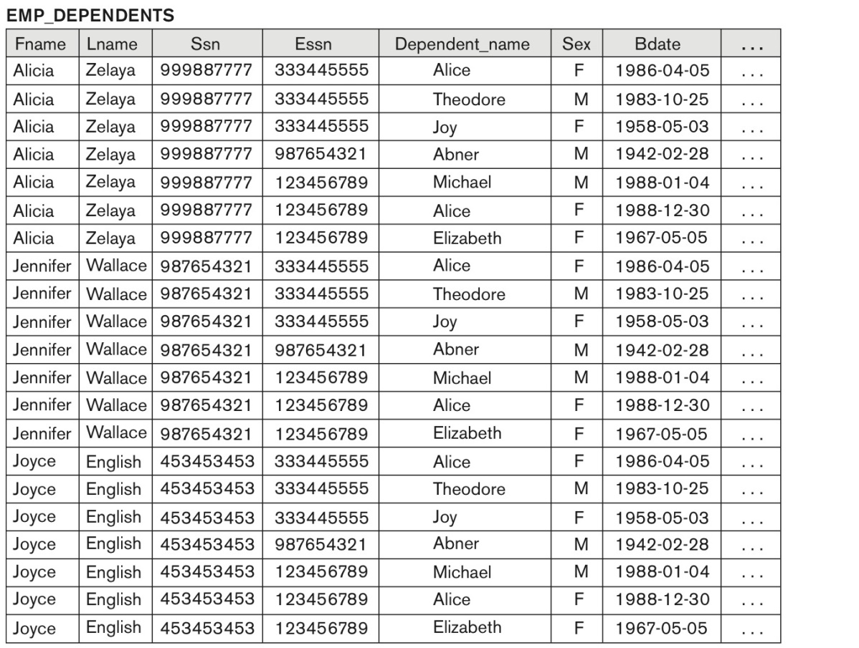
Example of CARTESIAN PRODUCT (CROSS PRODUCT) operation

